Slide 1
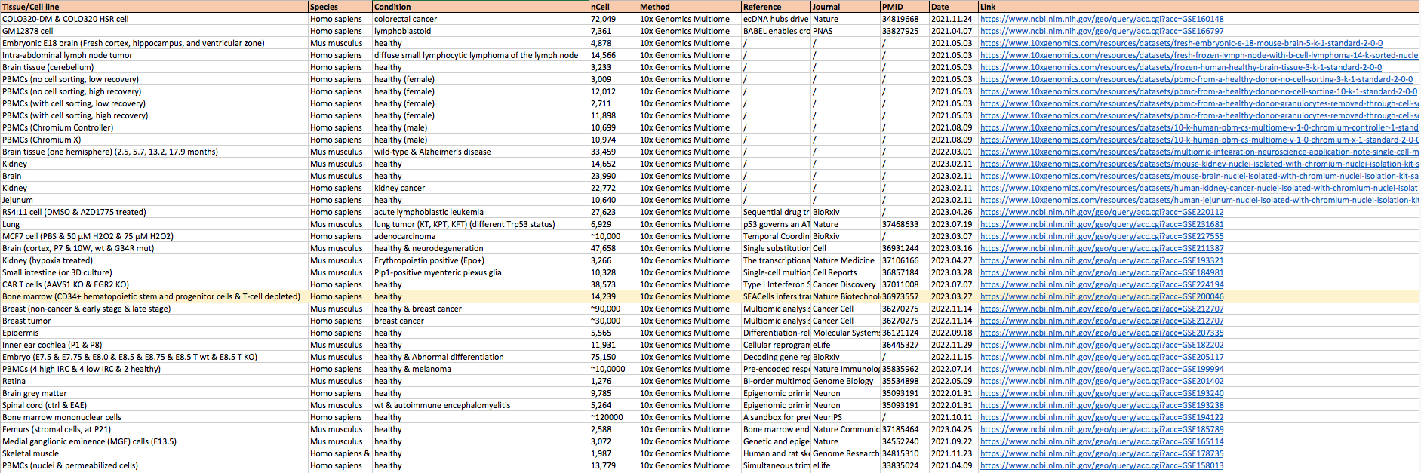
Paired scRNA-seq and scATAC-seq data (from 10x Genomics Multiome)
Keywords: 10x genomics multiome
https://www.ncbi.nlm.nih.gov/geo/

Slide 2
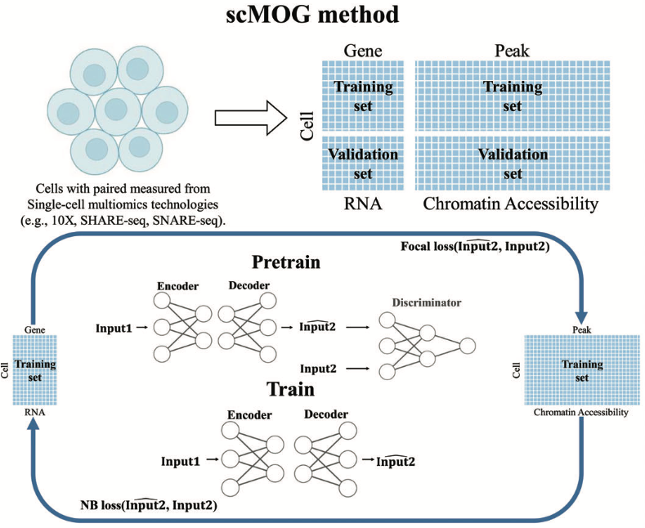
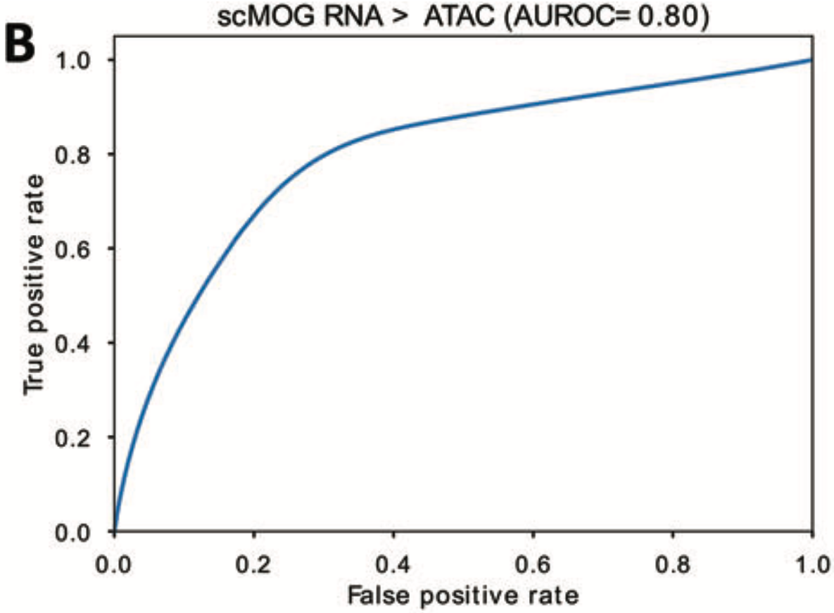
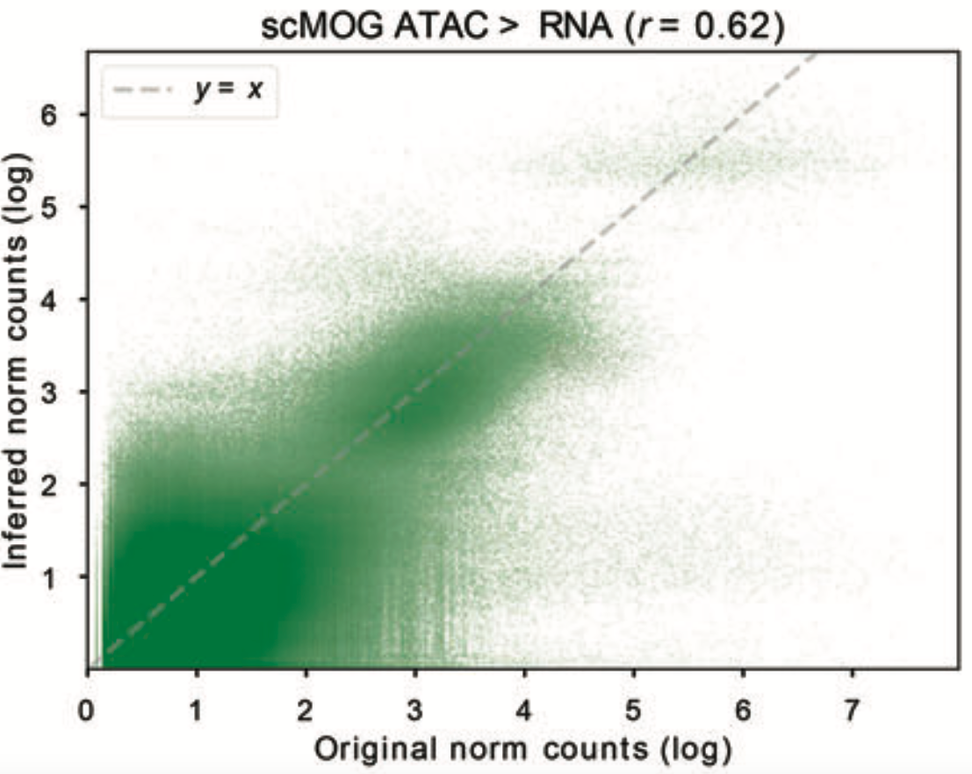
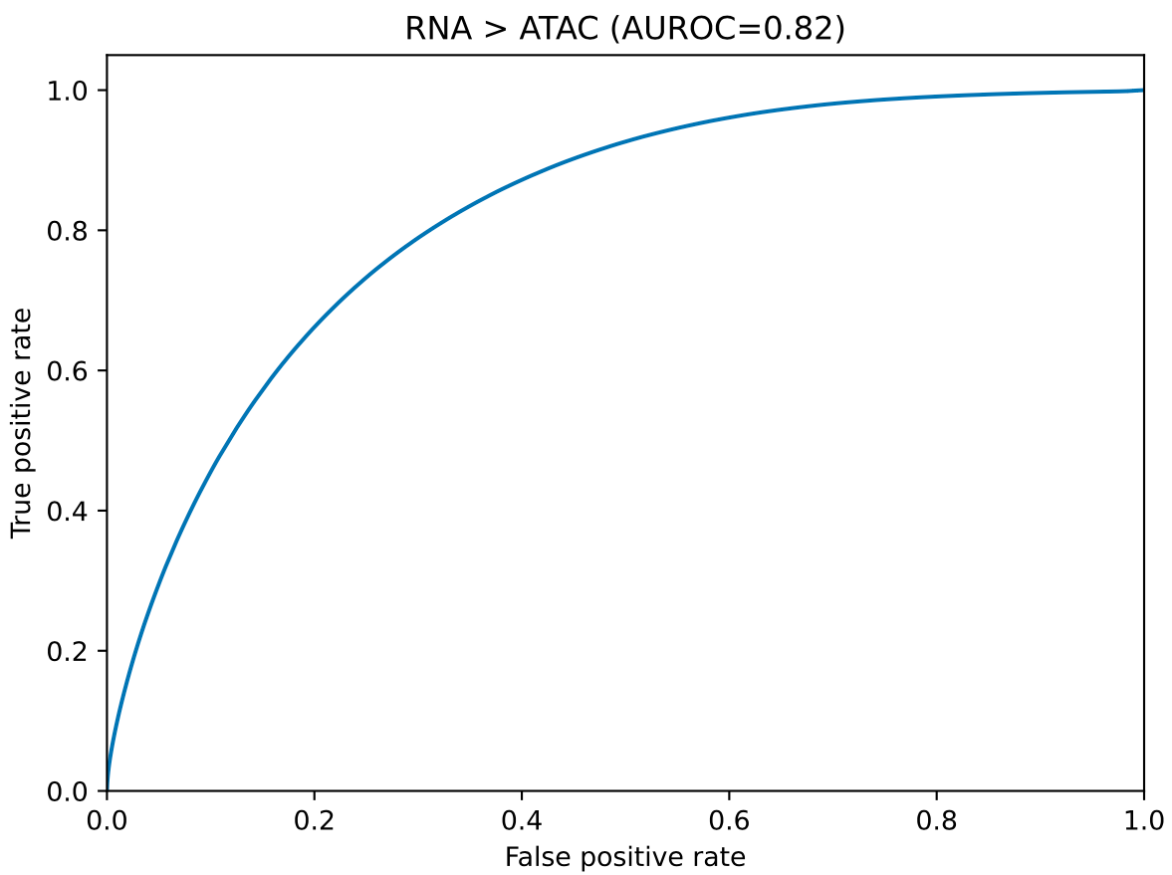
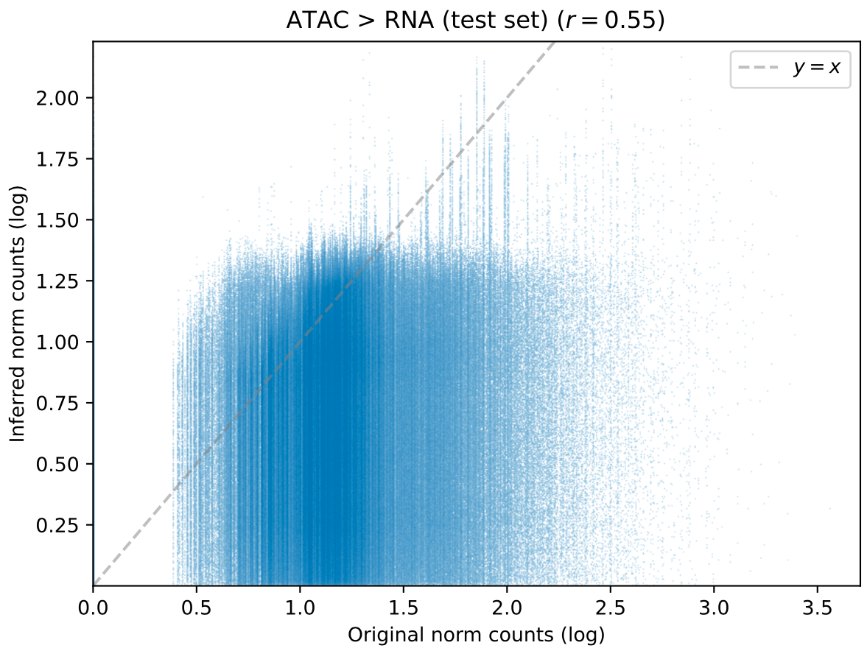
Single cell modality translation using scMOG
5,207 (training)
7,439 bone marrow cells
1,116 (validation)
Persad S, et al. Nature Biotechnology. 2023.
1,116 (testing)
random split? clustering-based split?
189,332 peaks & 16,466 genes
Input data: h5 file containing both RNA and ATAC paired modalities
Lan M, et al. Advanced Science. 2023.

Slide 3
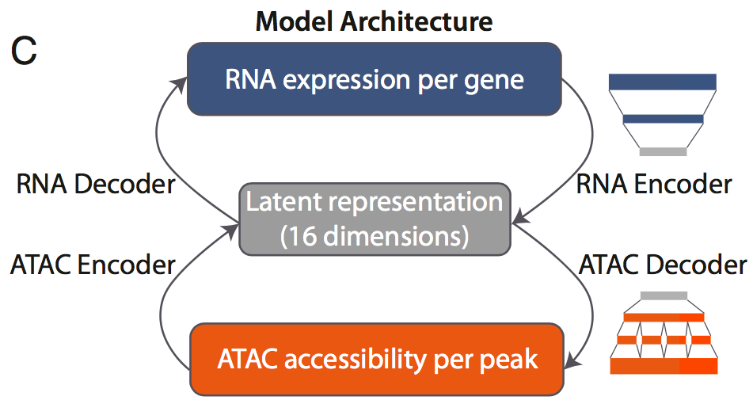
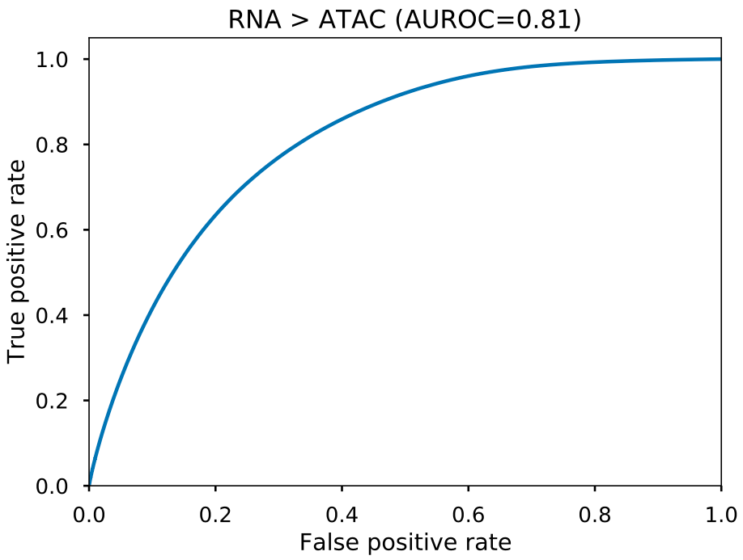
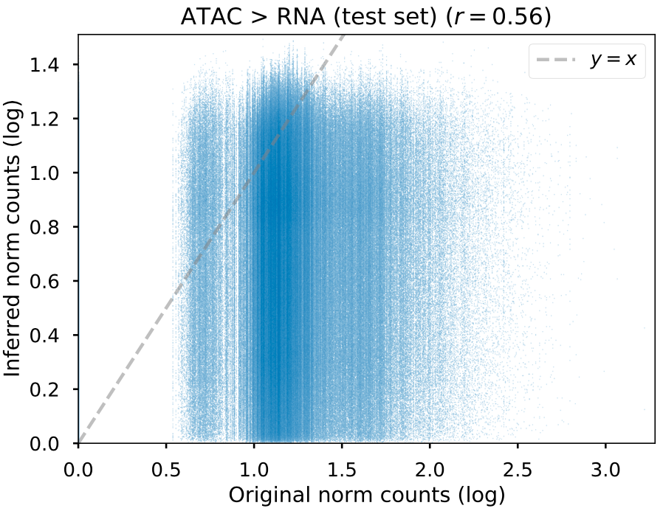
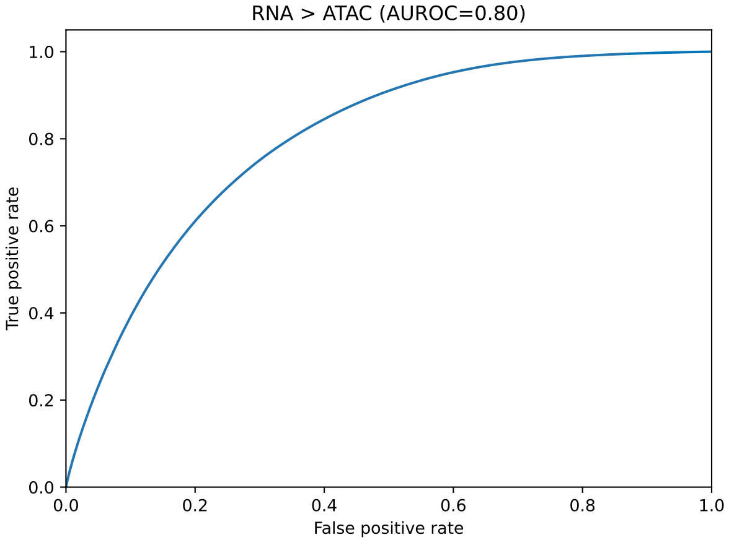
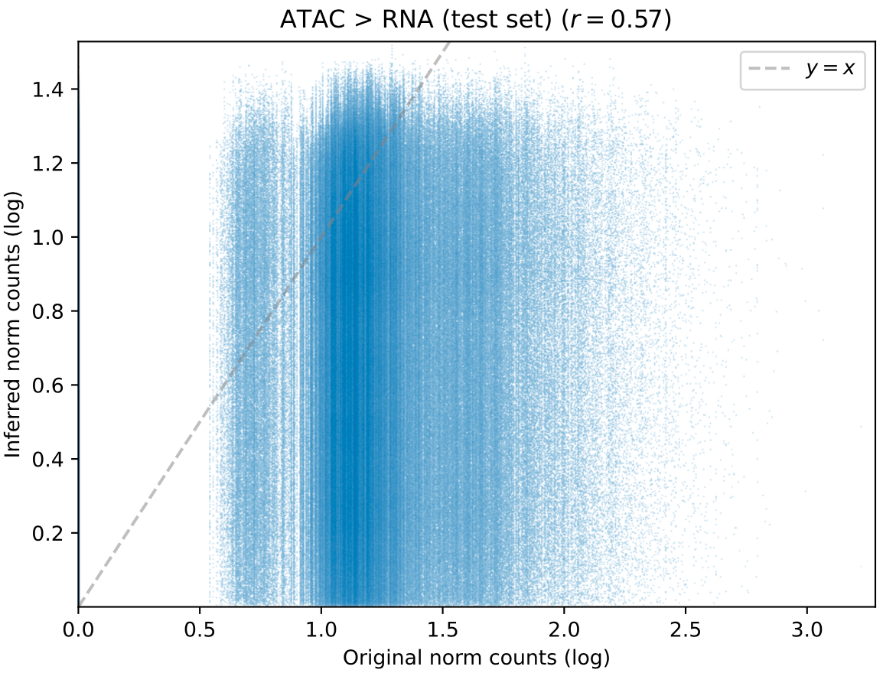
Single cell modality translation using BABEL and scMOG
Leiden clustering based dataset splitting
5,564 (training)
7,439 bone marrow cells
1,116 (validation)
7,59 (testing)
Persad S, et al. Nature Biotechnology. 2023.
BABEL
scMOG
Wu KE, et al. PNAS. 2021.
Lan M, et al. Advanced Science. 2023.

Slide 4
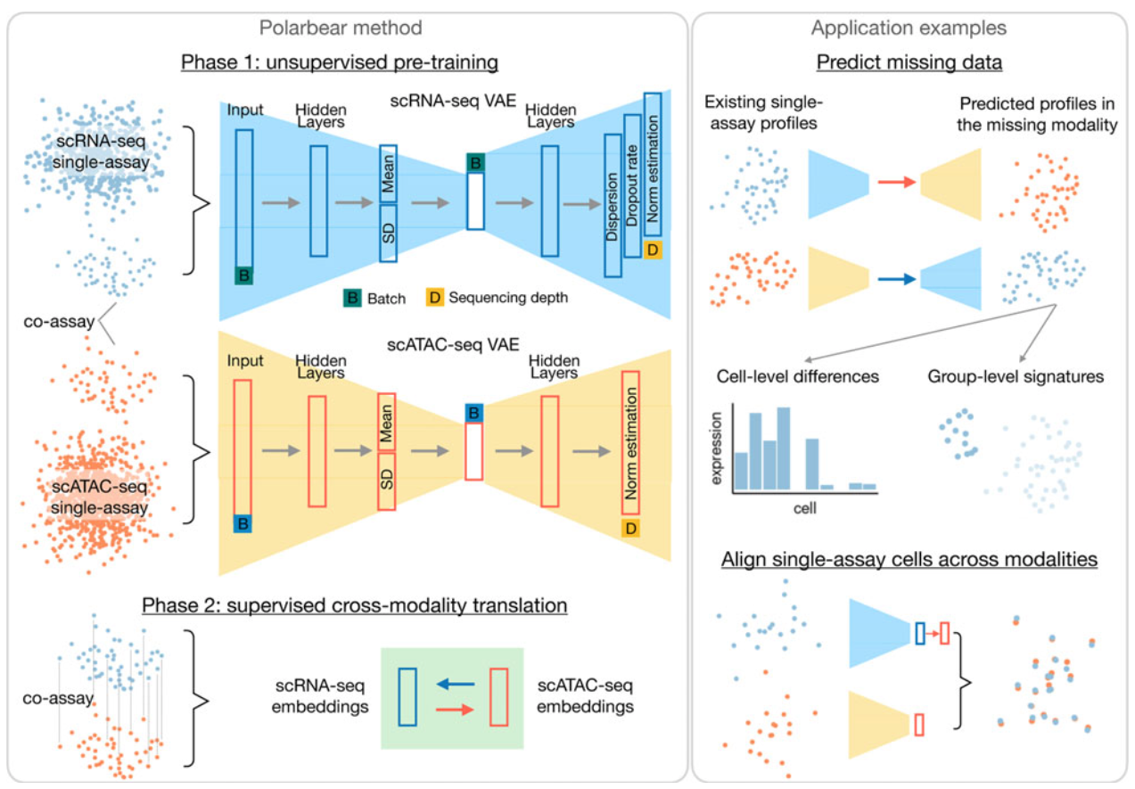
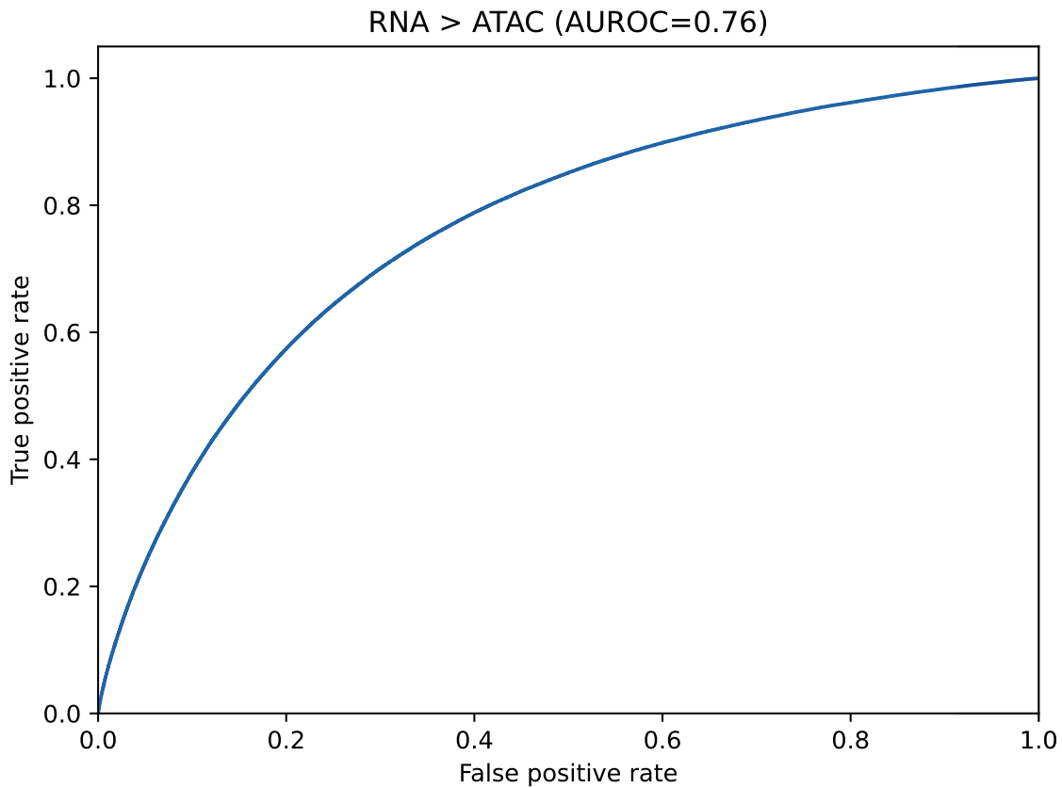
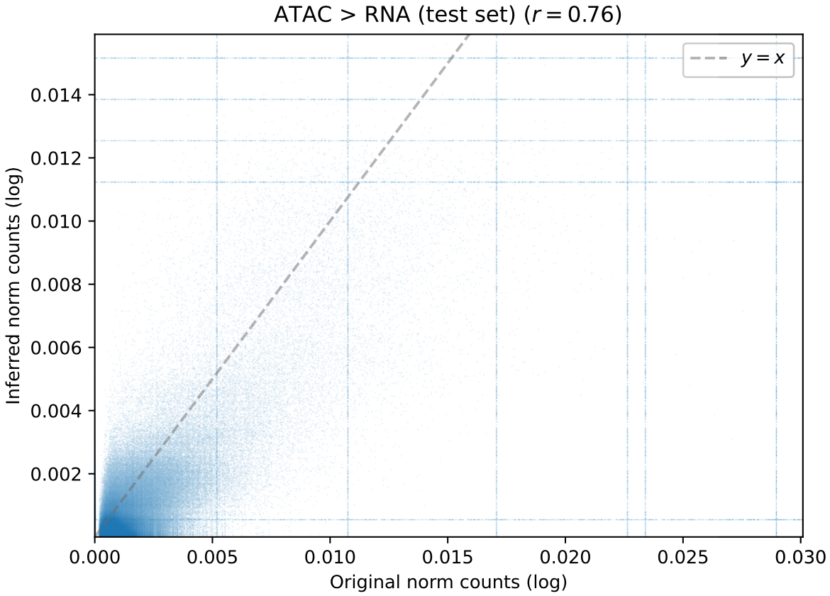
Single cell modality translation using Polarbear
Tissue: adult mouse brains Peak number: 189,332 Gene number: 16,466
Training step | Total epoch | Total time | Time per epoch | Input cell number
1. scATAC-seq -> scATAC-seq | 162 | 13 h | 5 min | 170,442
2. scRNA-seq -> scRNA-seq | 88 | 4.5 h | 2.5 min | 160,796
3. scATAC-seq -> scRNA-seq | 98 | 0.5 h | 20 s | 10,309
4. scRNA-seq -> scATAC-seq | 98 | 0.5 h | 20 s | 10,309
(GPU number: 1 Memory: 65 GB Batch size: 512)
Zhang R, et al. Journal of Computational Biology. 2022.

Slide 5
Paired scRNA-seq and scATAC-seq data (from SNARE-seq and SHARE-seq)
SNARE-seq (from Kun Zhang lab)
SHARE-seq (from Jason D. Buenrostro lab)

Slide 6
Paired scRNA-seq and scATAC-seq data (from sci-CAR and Paired-seq)
sci-CAR (from Jay Shendure lab)
Paired-seq (from Bing Ren lab)

Slide 7
Paired scRNA-seq and scATAC-seq datasets
scCAT-seq (from BGI-Shenzhen)
ASTAR-seq (from Yuin-Han Loh lab)
ISSAAC-seq (from Xi Chen lab)
M2C-seq (from X. Sunney Xie lab)
SNuBar−ARC (from Nicholas E. Navin lab)
Joint scATAC-seq/scRNA-seq (from Paul C. Blainey lab)

Slide 8
List of paired scRNA-seq and scATAC-seq technologies
Method | Date | Reference
sci-CAR | 2018.08.30 | Joint profiling of chromatin accessibility and gene expression in thousands of single cells
scCAT-seq | 2019.01.28 | Deconvolution of single-cell multi-omics layers reveals regulatory heterogeneity
Joint scATAC-seq/scRNA-seq | 2019.08.28 | Simultaneous Profiling of Gene Expression and Chromatin Accessibility in Single Cells
SNARE-seq | 2019.10.14 | High-throughput sequencing of the transcriptome and chromatin accessibility in the same cell
Paired-seq | 2019.11.06 | An ultra high-throughput method for single-cell joint analysis of open chromatin and transcriptome
ASTAR-seq | 2020.07.22 | Parallel bimodal single-cell sequencing of transcriptome and chromatin accessibility
10x Multiome | 2020.08.07 | https://www.10xgenomics.com/products/single-cell-multiome-atac-plus-gene-expression
SHARE-seq | 2020.10.23 | Chromatin Potential Identified by Shared Single-Cell Profiling of RNA and Chromatin
SNuBar−ARC | 2021.10.21 | Simple oligonucleotide-based multiplexing of single-cell chromatin accessibility
ISSAAC-seq | 2022.09.15 | ISSAAC-seq enables sensitive and flexible multimodal profiling of chromatin accessibility and gene expression in single cells
M2C-seq | 2022.09.26 | Highly sensitive single-cell chromatin accessibility assay and transcriptome coassay with METATAC

Slide 9
scTranslation outperforms other benchmark algorithms across multiple joint profiling datasets
 |  | sci-CAR | scCAT-seq | SNARE-seq | Paired-seq | ASTAR-seq | 10x Multiome | SHARE-seq | SNuBar−ARC | ISSAAC-seq | M2C-seq
ATAC > RNA (Pearson correlation) | scTranslation | …
 | BABEL
 | Polarbear
 | scMOG
 | CMOT
RNA > ATAC (AUROC) | scTranslation | …
 | BABEL
 | Polarbear
 | scMOG
 | CMOT
model_no_pre-train
model_with_pre-train_small
model_with_pre-train_large
Homo sapiens & Mus musculus?
Polarbear provides only mouse data for pre-training?
keep train/test splits the same for all methods!

Slide 10
All-wise
 |  | sci-CAR | scCAT-seq | SNARE-seq | Paired-seq | ASTAR-seq | 10x Multiome | SHARE-seq | SNuBar−ARC | ISSAAC-seq | M2C-seq
ATAC > RNA (Pearson correlation) | scTranslation
 | BABEL
 | Polarbear
 | scMOG
 | CMOT | 0.349
RNA > ATAC (AUROC) | scTranslation
 | BABEL
 | Polarbear
 | scMOG
 | CMOT | 0.539

Slide 11
Cell-wise
 |  | sci-CAR | scCAT-seq | SNARE-seq | Paired-seq | ASTAR-seq | 10x Multiome | SHARE-seq | SNuBar−ARC | ISSAAC-seq | M2C-seq
ATAC > RNA (Pearson correlation) | scTranslation
 | BABEL
 | Polarbear
 | scMOG
 | CMOT | 0.398
RNA > ATAC (AUROC) | scTranslation
 | BABEL
 | Polarbear
 | scMOG
 | CMOT | 0.547

Slide 12
Gene/Peak-wise
 |  | sci-CAR | scCAT-seq | SNARE-seq | Paired-seq | ASTAR-seq | 10x Multiome | SHARE-seq | SNuBar−ARC | ISSAAC-seq | M2C-seq
ATAC > RNA (Pearson correlation) | scTranslation
 | BABEL
 | Polarbear
 | scMOG
 | CMOT | 0.0048
RNA > ATAC (AUROC) | scTranslation
 | BABEL
 | Polarbear
 | scMOG
 | CMOT | 0.50

Slide 13
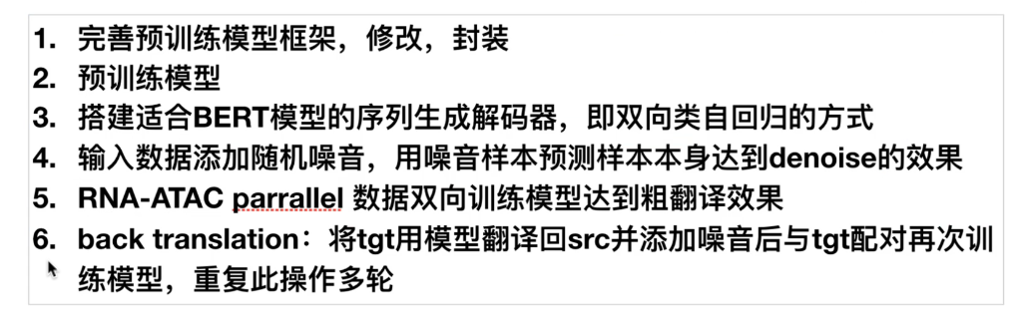
Future work
Fig. 1 Overview of scTranslation framework
Fig.2 scTranslation outperforms other benchmark algorithms across multiple joint profiling datasets
Fig.3
Fig.4
Fig.5

